Slide 1


^{Section B}
3
4
Let’s go
UNIT
Traveling solo—A blessing overall!
To master the reading skill
Objectives
To understand the text
To practice the phrases and patterns
To learn about letter writing

Slide 2

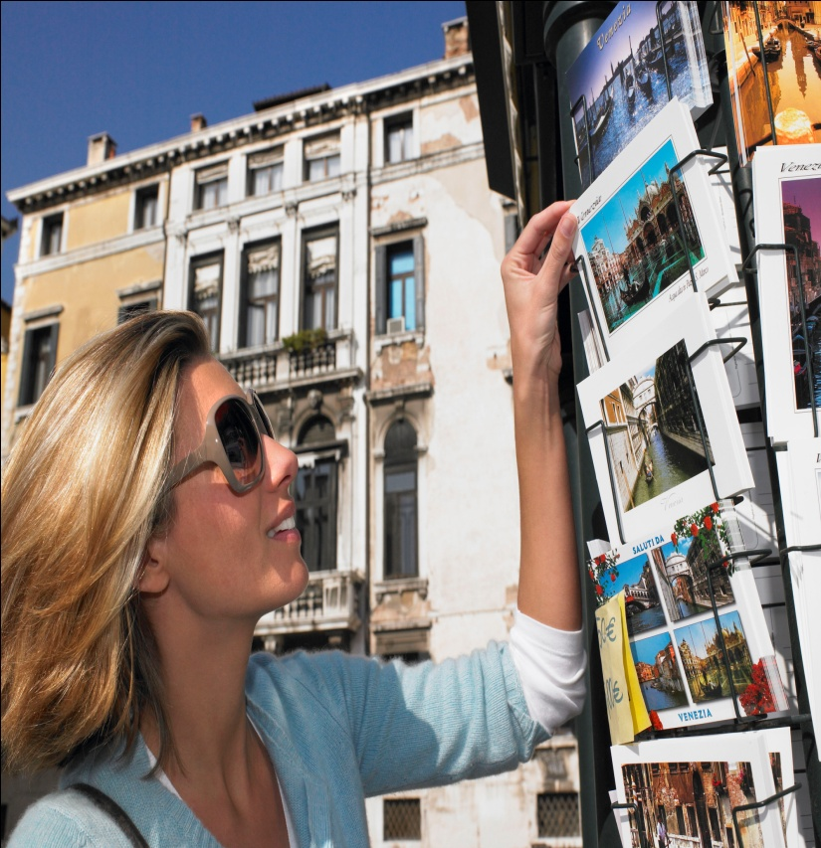




B
Traveling solo—A blessing overall!
Section
Contents
Warming-up
Reading Skills
Text Study
Comparative Study
Unit Project

Slide 3
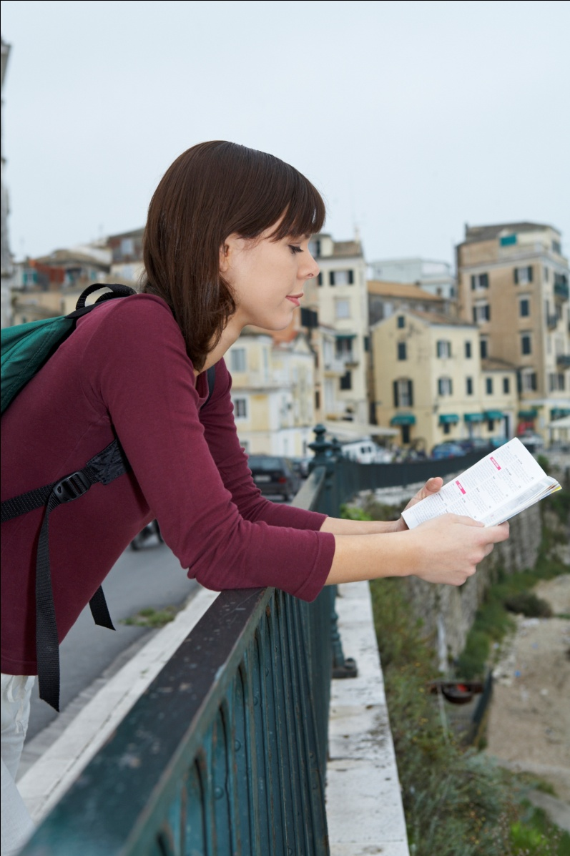


B
Traveling solo—A blessing overall!
Section
Warming-up
Lead-in
Background Information

Slide 4



1. What do many people dream of according to the video clip?
Tips
2. What did the young Chinese man do?
Tips
3. How has he benefited from the experience?
Tips
Video Watching

Slide 5
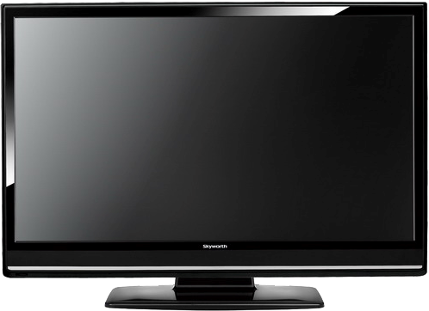

Back

Slide 6
1. What do many people dream of according to the video clip?
Tips
Many people dream of leaving everything behind to set off on an adventure that will take them to distant and exotic lands.

Slide 7
2. What did the young Chinese man do?
Tips
The young Chinese man cycled alone around Europe, with just a bike and a frisbee equipped. He took the paths from mountains to forests, from rugged roads to creeks. The journey was often strenuous with a new challenge waiting at every turn.

Slide 8
3. How has he benefited from the experience?
Tips
The solo travel has made a difference in his life. He didn't even know how to fix a bike before he started his tour. He set out on his journey armed with his passion for sports and his taste for a challenge but as he finished his trek, he discovered something much deeper. He reckons that to be oneself is important and his trip is doing what he loves. He hopes to inspire those like him to start living out their dreams.

Slide 9

Have you ever tried to do something solo? If yes, why did you choose so and how did you feel? If no, do you want to do something solo in the future? What’s that and why?

Slide 10


1. What is Youth Hostel?
Tips
2 . What do Youth Hostels provide?
Tips
3. What are the differences between Youth Hostels and hotels?
Tips

Slide 11

1. What is Youth Hostel?
Tips
A building that provides cheap and simple accommodations and meals especially to young people who are traveling.

Slide 12
2. What do Youth Hostels provide?
Tips
Youth Hostels provide budget-oriented, sociable accommodation where guests can rent a bed, usually a bunk bed, in a dormitory and share a bathroom, lounge and sometimes a kitchen. Rooms can be mixed or single-sex, although private rooms may also be available.

Slide 13
3. What are the differences between Youth Hostels
and hotels?
Tips
Compared with hotels, youth Hostels tend to be budget-oriented; rates are considerably lower, and many hostels have long-term residents whom they employ as desk clerks or housekeeping staff in exchange for free accommodations. They offer an informal environment and more common areas and opportunities for travelers to socialize.

Slide 14
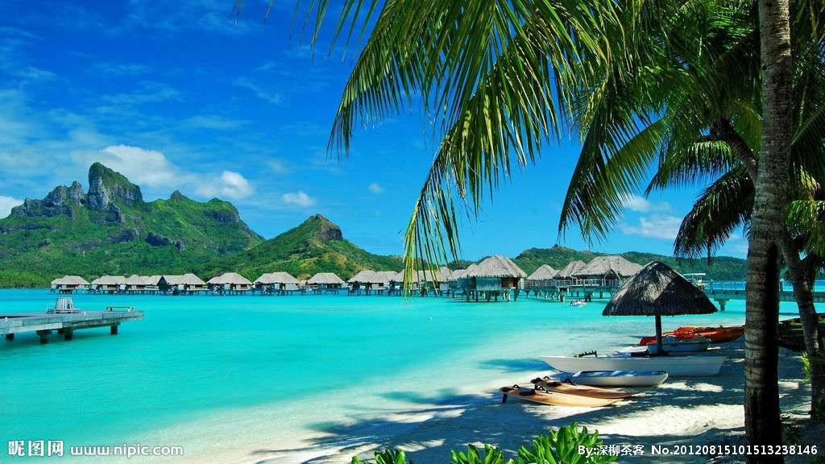

B
Traveling solo—A blessing overall!
Section
Reading Skills
Presentation of the Skill
Reading Skill Practice

Slide 15


Reading with your background knowledge
Good readers draw on prior knowledge and experience to help them understand what they are reading and are thus able to use that knowledge to make connections. Students can comprehend better when they make a text-to-self connection between a piece of reading material and their own life experiences.

Slide 16
Reading with your background knowledge
Once you are able to connect what you are reading with what you have experienced, you can surely comprehend the paragraph better. More importantly, you can also well
sense the underlying tone of the author, which is exactly what the author wants to drive at. Nevertheless, different readers might get a different hint from exactly the same reading material.

Slide 17
Reading with your background knowledge
Through making this text-to-self connection, you can see how this reading skill contributes to your understanding of the paragraph. Remember reading with your background knowledge not only connects you with the text, it also helps you think critically since your understanding of the text is continuously checked, confirmed, modified, or corrected during the reading process until you eventually come to understand the real purpose of the author.

Slide 18

Reading with your background knowledge
Read Paragraphs 1, 2, and 8 of Text B using the skill of reading with background knowledge. Think about the following questions:
What was your feeling when you were
reading these paragraphs?
Did you get a similar feeling or experience as
the author described ?
What is the author’s purpose of putting these
details in the text?

Slide 19


B
Traveling solo—A blessing overall!
Section
Text Study
Text Comprehension
Language Focus
Critical Thinking

Slide 20

Is travel difficult? And why? (Para. 2)
What does the author suggest when no one can travel with you? (Para. 3)
How did people react to the author’s traveling alone? (Para. 5)
Does the author regard her solo travel as a curse? Why? (Paras. 6-7)
According to the author, what problems can traveling alone bring? (Paras. 8-9)
What does the author think about traveling with a companion? (Paras. 10-11)
What should be avoided in order to protect yourself from danger in solo travel? (Para. 12)
What are the author’s opinions about traveling alone? (Paras. 13-14)

Slide 21

1. Is travel difficult? And why? (Para. 2)
Tips
Travel is difficult because we have to deal with many problems:
haven’t travel much;
can’t speak the language or read the signs;
have to do all the research for yourself, find
hotels, get yourself around...

Slide 22
2. What does the author suggest when no one can
travel with you? (Para. 3)
Tips
When no one can travel with you, the author has pointed out that traveling on your own is not a bad choice. You can:
ask everyone you know;
join a tour;
or go alone.

Slide 23


原句：
Unfortunately, right from the onset, none of your friends share that dream. (Para. 3, L2)
解释:
Unfortunately, right from the beginning, none of your friends have the same dream, nor will they go together with you.
译文：
但是不幸的是，刚一开始就没有朋友分享你的梦想。

Slide 24
3. How did people react to the author’s solo
travel? (Para. 5)
Tips
They thought it dangerous and hard to believe:
strange, inconceivable, reckless, more susceptible to violent or dangerous situations.

Slide 25
原句：
I made that trip to China, and then zigzagged on a multinational excursion through Indonesia, Thailand, England and France. (Para. 4, L2)
解释:
I traveled to China, and after that I also traveled to several other countries during one trip, including Indonesia, Thailand, England and France.
译文：
我先去了中国，然后辗转到了印度尼西亚、泰国、英国和法国，经历了一次多国之旅。

Slide 26
4. Does the author regard her solo travel as a curse?
Why? (Paras. 6-7)
Tips
No, she figures that traveling solo has its own problems but can also bring great benefits because she has cited two experiences in Taiwan to support her idea.
It’s sometimes a blessing, sometimes a curse.

Slide 27
5. According to the author, what problems can
traveling alone cause? (Paras. 8-9)
Tips
Traveling solo could be dangerous and put the traveler at the risk of being touched indecently, being threatened, or being overcharged, etc.
But there has also been the downside of those not-so-pleasant experiences:
In Indonesia/in Japan/in Italy/in China

Slide 28
原句：
In Indonesia, a cute boy gave me a ride on his motorbike, and thought that gave him license to grope me illicitly. (Para. 8, L1)
解释:
In Indonesia, a cute boy offered to take me for a ride on his motorbike, and thought that permitted him to touch me indecently.
译文：
在印度尼西亚，一个长相可爱的男孩儿让我
搭乘了他的摩托车，认为这样他就可以非礼
我。

Slide 29
原句：
I’ve been irritated and perplexed many times –not speaking a language, not understanding or being understood. (Para. 9, L1)
解释:
I have been annoyed and confused many times because I can’t speak a local language, thus unable to understand or be understood by others.
译文：
很多时候，我很苦恼，感觉不知所措，因为
不懂当地的语言，不能理解别人的意思， 别
人也不懂我说的话。

Slide 30
6. What does the author think about traveling with a
companion? (Para. 9)
Tips
The author maintains that traveling with a companion would have prevented the traveler from getting many opportunities, such as having different experiences, eating ethnic food, being nursed by strangers, to meet locals.
Notes:
上面挤，下面空

Slide 31
原句：
Other travelers can swap stories with you about the local folklore of the places they’ve been to and often have credible insights into the place you’re visiting. (Para. 11, L1)
解释:
Other travelers can share stories with you about the local traditions and customs of the places they’ve been to, and often they have deep understanding of the place you are visiting.
译文：
其他旅游者会给你讲他们到过地方的民间风情，对于
你正在旅行的地方，他们也会有令人信服的见解。

Slide 32
7. What should be avoided in order to protect yourself
from danger in solo travel? (Para.12)
Tips
Watch your back (处处提防), but avoid presuming the worst and being overly fear.
Be friendly with people, but watch out for those who are too friendly;
Don’t disregard (忽视) your instincts.

Slide 33
原句：
Of course you have to be careful not to endanger yourself by throwing caution to the wind. (Para. 12，L1)
解释:
Of course you should be careful not to put yourself in a dangerous position, and should always pay attention to the potential danger.
译文：
当然，你必须当心，不要因为大意而使自己处于
危险的境地。

Slide 34
8. What are the author’s opinions about traveling
alone? (Paras. 13-14)
Tips
The key to solo travel is to open your mind;
Everything that happens to you benefit you in some way;
Don’t ever let a lack of a companionship constrain you from travel solo.
Overall, solo travel is a blessing.

Slide 35
原句：
The key to solo travel is to open your mind,
close your eyes and leap in! (Para. 13, L1)
解释:
The key to solo travel is to be brave to accept new ideas, close your eyes and try it.
译文：
单独旅行的关键是敞开心扉，闭上眼睛，投
入其中！

Slide 36
原句：
Take those little annoyances, those inefficiencies, and those boring bureaucrats with a laugh. (Para. 13, L3)
解释:
Do not take too seriously those little annoyances, those inefficiencies, and those boring bureaucrats.
译文：
把那些小烦恼、那些拖拉低效的作风、那些
令人厌恶的官僚主义抛在脑后，一笑置之！

Slide 37
What is the thesis statement of the text?
Tips
Once you go solo, you’ll be amazed at how sensational your travel experiences will be.

Slide 38


Traveling solo—A blessing overall!
You are ready to travel. But You haven’t traveled much and have many problems to deal with. ______of your friends or families ______that dream. You could ________though it is a difficult decision. I traveled solo to China and after that to several other countries. My friends, acquaintances, co-workers and the natives from the countries I visited consider it _______, ______________, _________ and __________.
None
share
go alone
strange
inconceivable
reckless
dangerous

Slide 39
My solo travel has been sometimes a _______, sometimes a _____. Not-so-pleasant experiences in Indonesia, Japan, Italy, China have shown that traveling solo could also put me _______. Having a companion might have _________ me _____ some dangers, but it would have made me lose the opportunities to enjoy the trip, eat ___________, be ______ by strangers, meet _______in the trip.
blessing
curse
at risk
safeguard
from
ethnic food
nursed
locals

Slide 40
But you have to be careful not to endanger yourself by throwing _______to the wind. _______________, close your eyes and leap in! Everything that happens to you will ________you in some way. Don’t ever let a lack of companionship _________you from doing traveling solo because traveling solo is a blessing overall.
caution
Open your mind
benefit
constrain

Slide 41

Practical Phrases | Specific Meanings
1. take sth. off | 休假
2. license to do sth. | 对做坏事的放纵
3. safeguard sb./sth. from/against sth. | 保护使免遭...
4. throw / Cast caution to the wind(s) | 不顾一切;鲁莽行事
5. watch one’s back | 警惕；提防
6. watch (out) for | 当心；密切注意
7. open one’s mind | 乐于考虑（接受）
8. constrain sb. from doing sth. | 限制某人做某事

Slide 42

休假
短语逆译
take some time off
短语应用
我认为你最近工作太辛苦了，真应该抽出时间去度度假。
意群提示
( work too hard/take sth. off )
I think that you have worked too hard recently and really ought to take some time off for a holiday.

Slide 43
对做坏事的放纵
短语逆译
license to do sth.
短语应用
你无权因为生气而对别人如此粗鲁。
意群提示
(give sb. license to do/treat sb. rudely)
Being angry doesn’t give you license to treat others so rudely.

Slide 44
safeguard sb./sth. from/against sth.
保护使免遭…
短语逆译
短语应用
这个公司没有保护好工人，让他们遭受了危险化学品的侵害，因而受到指责。
意群提示
(be blamed for/ safeguard ...from/against sth.)
The company was blamed for failing to safeguard its workers against dangerous chemicals.

Slide 45
throw / cast caution to the wind(s)
不顾一切;鲁莽行事
短语逆译
短语应用
在这种时候，很多投资者可能会不顾一切，愿意一头扎进去而不计后果。
意群提示
(feel an urge to do sth./ throw caution to the wind/jump in head)
At times like this, a lot of investors may feel an urge to throw caution to the wind and jump in head first.

Slide 46
警惕；提防
短语逆译
watch one’s back
短语应用
皮特曼是无畏的，但是他也是精明的，知道要小心提防。
意群提示
(fearless/ shrewd/watch one’s back)
Pitman was fearless. But Pitman was also shrewd and knew to watch his back.

Slide 47
当心；密切注意
短语逆译
watch (out) for
短语应用
这听起来像是一个双赢的局面，但是要注意协议的条款。
意群提示
(win-win situation/ watch out for/ terms of the deal)
It may sound like a win-win situation, but watch
out for the terms of the deal.

Slide 48
乐于考虑（接受）
短语逆译
open one’s mind
短语应用
年轻人总是乐于接受新鲜事物。
意群提示
(be ready to do/ open one’s mind)
Young people are always ready to open their mind to new things.

Slide 49
限制某人做某事
短语逆译
constrain sb. from doing sth.
短语应用
警察难以制止人群冲进足球场地。
意群提示
(have difficulty in/ constrain sb. from doing/the football pitch)
The policemen had difficulty in constraining the crowd from rushing onto the football pitch.

Slide 50

Functional Patterns | Functions & Usages
1. The reactions from ... and especially from ... show/reveal sb. that .... | 用于表达“人们对某事物的反应或看法”
2. Sth. might have helped do .... But it would have done … | 对一件事情的辩证分析，用于表达 “事物可能存在的优势及劣势”。
3. As it turned out, sb. do (does) sth. / sth. do (does). | 用于表达“本该某事发生的时候，实际所发生的是另外的情形”。
4. Once sb. do(does) sth, sb. Will be + amazed / disappointed / angry, etc. at ... | 用于表达“某人做某事后可能出现的效应或后果”。
Notes:
50

Slide 51
原句译文
但是从我认识的人、旅友，尤其是我所到国家的居民的反应得知，很多人觉得独自旅行很怪异，甚至会觉得不可思议和欠考虑。
逆译练习
But the reactions I’ve gotten, from people I know, fellow travelers, and especially, from the natives of the countries I’ve visited, showed me that solo traveling is strange, and even considered inconceivable or reckless by many people. (Para. 5, L1)
句型提炼

Slide 52

句型提炼
The reactions from ... and especially from ... show/reveal sb. that ....
应用提示
用于表达“人们对某事物的反应或看法” 。
句型应用

Slide 53
典型例句
从他的朋友，同事，尤其是他父母的反应得知，很多人觉得他辞掉高薪工作去旅游的是草率的、不靠谱的。
意群提示
(fellow workers/ well-paid job/ rash and crazy)
The reactions he has gotten, from fellow workers, friends, and especially, from his parents show him that his decision to quit well-paid job to travel is rash and crazy.

Slide 54
原句译文
如果身边有一个同伴陪着我，也许就能使我避免刚刚讲的那些问题,但是这也会使我错失其他的机会，
逆译练习
Having a companion might have helped safeguard me from some of those problems. But it would have suppressed other opportunities … (para. 3, L1）
句型提炼

Slide 55
句型提炼
Sth. might have helped do .... But it would have done …
应用提示
对一件事情的辩证分析，用于表达 “事物可能存在的优势及劣势”。
句型应用

Slide 56
典型例句
上地方大学而不是军校，也许能给我们带来更多的自由。帮助。但是这也会使我们失去我们成长为真正的男子汉自由。
意群提示
(a civilian university/grow into a real man)
Attending a military university rather than a civilian one might have helped offered us a freer life. But it would have made us miss the chance to grow into a real man.
Notes:
意群提示字号小么？

Slide 57
原句译文
结果，这个女孩儿让我在她的公寓住了一晚，甚至第二天还让她的一个朋友带我在这座城市转了转。
逆译练习
As it turned out, she was offering to let me stay at her flat and even had a friend come show me around the city the next day. (Para. 6, L4)
句型提炼
Notes:
框框有点多，页面不够简洁，下同

Slide 58
句型提炼
As it turned out, sb. do(does) sth. / sth. do(does).
应用提示
用于表达“本该某事发生的时候，实际所发生的是另外的情形”。
句型应用

Slide 59
典型例句
他们说修理要花费大概 20 万美元， 但最后账单却是该数额的两倍。。
意群提示
(the repairs/ the final bill/ twice that amount )
They said the repairs would cost around 200,000
dollars, but as it turned out, the final bill was twice that
amount.

Slide 60
原句译文
一旦你独自一人去旅行，你会惊奇地发现你的旅行经历将会是多么美好。。
逆译练习
Once you go solo, you’ll be amazed at how sensational your travel experiences will be. (Para.14,L2)
句型提炼

Slide 61
句型提炼
Once sb. do(does) sth, sb. will be+amazed /disappointed/angry, etc. at ...
应用提示
用于表达“某人做某事后可能出现的效应或后果” 。
句型应用

Slide 62
典型例句
一旦你冲动之下告诉他真相，你会失望地发现他竟然会如此懦弱。
意群提示
(tell the truth/ on impulse/ cowardly)
Once you tell him the truth on impulse, you will be disappointed at how cowardly he will be.

Slide 63

1.比如说 | let’s say...
2.被...所吸引 | be fascinated with
3.省下一笔钱 | have a chunk of money saved
4.自己到处逛 | get oneself around
5.辗转到了 | zigzag through
6.经历了一次多国 之旅 | on a multinational excursion
7.容易遭遇... | be susceptible to sth.
8.不愉快的负面经历 | the downside of not-so-pleasant experiences

Slide 64
9.让某人搭乘摩托车 | give sb. a ride on the motorbike
10.愿意付钱让人陪游 | be willing to pay for one’s company
11.错失机会 | suppress opportunities
12.豪华宾馆 | a fancy hotel
13.民族风味的食物 | ethnic food
14.与...坦诚相待 | be upfront with
15. 与人为善 | be friendly with
16.对...一笑置之 | take ...with a laugh
b

Slide 65


单独旅行有时是件好事，有时则不然。
a. This has been sometimes a blessing, sometimes a curse.

Slide 66
要处处提防，但是也不要把什么事都想成最坏的，过于担惊受怕。要对人友善，但需防备那些对你过于友好的人。
b. Watch your back, but don’t presume the worst and be overly fearful. Be friendly with people, but watch out for those who are too friendly with you.

Slide 67
单独旅行的关键是敞开心扉，闭上眼睛，投入其中!
c. The key to solo travel is to open your mind, close your eyes and leap in!

Slide 68
所有发生在你身上的事情都是一种经历，无论是好的，坏的，或是不好不坏的，将来总会对你有益。
d. Everything that happens to you is an experience, and good, bad or neutral, they will all benefit you in some way.

Slide 69
永远不要因为缺少同伴而不去做你真正想做的事情。
e. Don’t ever let a lack of companionship constrain you from doing what you really want to do.

Slide 70


1. What are pros and cons of traveling solo and traveling with company?
Tips
2. What are the differences in the choice of traveling
solo between Chinese or Americans? Why?
Tips
3. Will you constrain yourself from doing what you
really want to because of a lack of companionship?
Tips

Slide 71
1. What are pros and cons of traveling solo and
traveling with company?
Tips
Traveling Solo
Pros:
Personal growth- time for reflection, discovering your personality and needs;
Learning new skills (time management, decision making);
Gaining independence and self-confidence;
More interactions with locals and foreigners;
Enjoy more freedom and arrange your tour as you wish.

Slide 72
1. What are pros and cons of traveling solo and traveling with company?
Tips
Traveling Solo
Cons:
Loneliness–you can be more homesick and suffer from cultural shock
More dangerous—no one who can watch your bag or be with you in case of illness or another emergency situation
Might be less fun—some locals might not get your jokes or have different attitude towards some stuff

Slide 73
1. What are pros and cons of traveling solo and traveling with company?
Tips
Traveling with company
Pros:
Safe and more convenient—there is always someone to watch your stuff and make sure you won’t get hurt
More fun—cracking jokes, having fun together
Less expensive—you share expenses with your travel mate
Have someone to share your memories with

Slide 74
1. What are pros and cons of traveling solo and traveling with company?
Tips
Traveling with company
Cons:
Being with the same person/people 24/7 can be very annoying (you could lose your friendship over this)
Memories of your trip may turn out to be nightmares (constant fighting over where to go and what to see, etc.)
Traveling as group may make it more difficult to meet other people because groups tend to be prone to exclusivity and can be intimidating to other travelers

Slide 75
2. What are the differences in the choice of traveling
solo between Chinese or Americans? Why?
Tips
Americans’ individualism, love for adventure, independence, and desire for freedom make it possible for them to travel solo. They enjoy the process of travel. They reckon that venturing out alone renews their spirit in the most positive way, changes the way they look at things, helps them get to know themselves better, become mentally stronger and more capable, learn to embrace being around unfamiliar places, people and all of the challenges that will present itself on the road.

Slide 76
2. What are the differences in the choice of traveling
solo between Chinese or Americans? Why?
Tips
However, Chinese prefer to travel with company. Though Independent travel is much more common, it still confines itself to an absolute minority. Conservative and prudent, Chinese people consider travel solo risky and dangerous and focus on its negative aspects. They like to travel with friends, families or colleagues to guard themselves against dangers and problems. They prefer to choose famous and safe traveling spots.

Slide 77
3. Will you constrain yourself from doing what you
really want to because of a lack of companionship?
Tips
In my opinion, lacking companionship cannot be an excuse to stop pursuing our dreams. We want to go somewhere because there is a strong urge deep in our heart which drives us to accomplish this dream. It is our own decision and destination. A lack of companionship should not be a barrier that stops us.

Slide 78
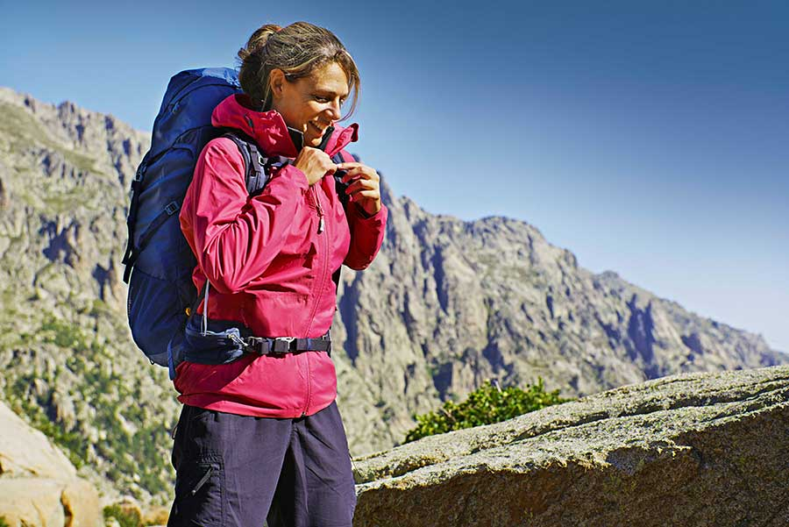
Talk about the definition of the word “travel(旅行)” in western culture and in Chinese culture.

Slide 79
1. What does “travel” mean in Western culture
and in Chinese culture?
Tips
2. Is a tourist a traveler? Why?
Tips

Slide 80
1. What does “travel” mean in western culture and in Chinese culture?
“The word “travel” comes from the Old French word “travail” (or “travailler”), which means “to work, to labor; a suffering or painful effort, an arduous journey, a tormenting experience.” “Travel,” thus, is "a painful and laborious journey". The Mandarin Chinese word for “travel” is “lu xing,” which means going on a long journey with company with or without a purpose, recorded in the book of rites. Therefore, Chinese prefer to travel with company rather than go alone though solo travel is more common than before.
Tips

Slide 81
2. Is a tourist a traveler? Why?
Tips
A traveler must be different from a tourist. American writer Daniel J. Boorstin once penned, “The traveler was active; he went strenuously in search of people, of adventure, of experience. The tourist is passive; he expects interesting things to happen to him. He goes ‘sight-seeing.’” According to the English journalist, novelist, and essayist Gilbert K. Chesterton, “The traveler sees what he sees, the tourist sees what he has come to see.”

Slide 82
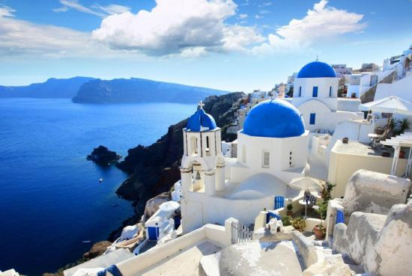
B
Traveling solo—A blessing overall!
Section
Comparative Study
Thematic Study
Thematic study
Language Features Analysis

Slide 83



1. Comparison between “why we travel” and
“why we travel solo”.
Tips
2. As college students, would you like to travel? Why? Alone or with company?
Tips

Slide 84
Comparison between “why we travel” and “why we travel solo”.
Why we travel
Why we travel solo
1.Travel loosens the cognitive chain imprisoning us.
2.Experienced travelers are open to ambiguity; they interpret the world in different ways.
3.Thesis statement:
We travel because distance and difference are the secret cornerstones of creativity.
1.Solo travel has been sometimes a blessing and sometimes a curse；
2.It may offer many opportunities for her to enjoy her travel.
3. Thesis statement:
All experiences obtained through solo travel, good or bad, will definitely be valuable treasures in our life.

Slide 85
2. As college students, would you like to travel? Alone or with company? Why?
Tips
As a college student, I’d like to travel to many places to broaden my horizons, as implied in Chinese proverb “Read many books and travel a long way”. After traveling with friends several times, I will choose to travel on my own. I believe traveling alone can make me courageous, decisive, independent, open-minded, and optimistic, which prepare me for the future challenges in my life.

Slide 86


Based on your study of the two texts, compare the writing styles of the two texts in terms of their typical language features.

Slide 87
1. What are the typical language features of the two texts?
Tips
2. List more examples from the text to support your ideas.
Tips

Slide 88
1. What are the typical language features of the two texts?
Tips
Text A employs more rhetorical devices such as personification and parallelism.
Text B is much more casual and colloquial than Text A. Perhaps the most obvious characteristic is the pronouns “you”, “I”, at the beginning of many sentences. Imperative sentences can also be found everywhere in this text.

Slide 89
2. List more examples from the text to support your ideas.
Tips
Text A
Personification :
my alarm clock has just stolen away a lovely dream.
Parallelism:
Because home is boring. Because the flights are on sale. Because Paris is Paris.

Slide 90
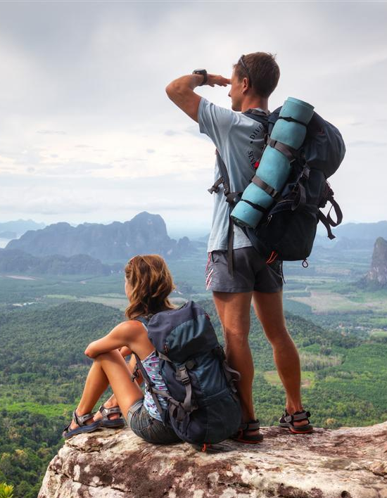

B
Traveling solo—A blessing overall!
Section
Unit Project
Quotes About Traveling
Trip planning
Letter Writing

Slide 91

Quotes About Traveling
The World is a book, and those who do not travel read only a page.
— St. Augustine

Slide 92
Quotes About Traveling
No one realizes how beautiful it is to travel until
he comes home and rests his head on his old,
familiar pillow.
—Lin Yutang

Slide 93
Quotes About Traveling
Never did the world make a queen of a girl who hides in houses and dreams without traveling.” ― Roman Payne, The Wanderess

Slide 94

Trip planning
Work in groups and talk about your three-day travel plan.
Including:
budget
transportation and accommodations
places you’d like to visit
clothing you’d like to take, etc.
detailed schedule.

Slide 95
Watch the video clip again and write a letter to college students in the name of Xu, jiangjun in the video.
Letter Writing

Slide 96

Letter Writing
Writing a Letter to college students
You may include the following points:
Your travel experiences;
Your reason for traveling;
difficulties or problems you have encountered;
Your advice to college students.

Slide 97

Letter Writing
You may use the following expressions in your writing.
The thrill of being someplace new
To endows sb. with a valuable open-mindedness
The downside of not-so-pleasant experiences;
To have credible insights into.;
To endanger oneself by throwing caution to the wind;
Once you do sth., you’ll be amazed at...

Slide 98
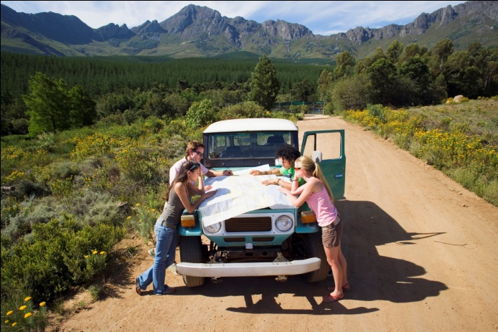


B
Traveling solo—A blessing overall!
Section
The end

